Slide 1
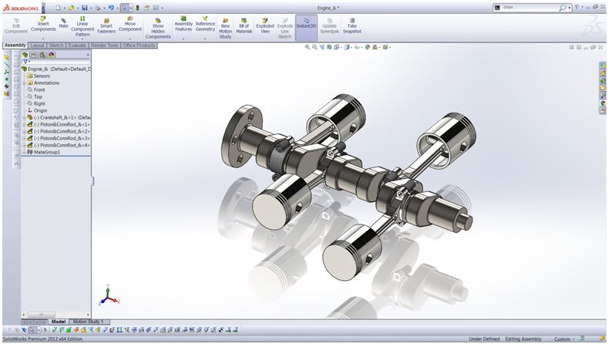
Mechanical Engineering Project
Mechanical Shaft
& Support
Component Design
CAD-Based Design & Modeling
January 2026
01
Precision Engineering

Slide 2
Navigation
Project
Overview
01
Introduction
02
Objectives
Project scope and objectives
Design goals and targets
03
Components
04
Features
Shaft and support parts
Key design elements
05
Methodology
06
Engineering
Design process steps
Technical considerations
A comprehensive exploration of mechanical shaft design methodology, from conceptualization to CAD implementation.
07
Skills & Tools
08
Outcomes
9 Sections
Capabilities developed
Key learnings gained
Structured Content

Slide 3
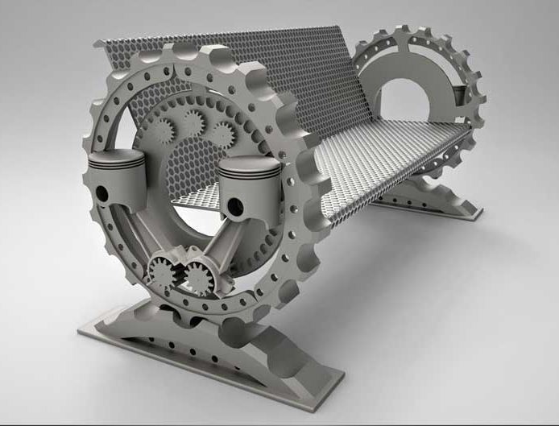
Section 01
01
Introduction
Project Focus
This project centers on the design and modeling of a mechanical shaft along with its supporting structure using advanced CAD software. The development process strictly adheres to engineering drawing standards and precise dimensional specifications.
Learning Purpose
The primary objective is to enhance practical understanding of mechanical design principles and component modeling techniques. This hands-on experience bridges theoretical knowledge with real-world engineering applications.
CAD Modeling
Precision Design

Slide 4
Section 02
Project Objectives
Four strategic goals guiding the design process
01
Precise Shaft Model
02
Correct Dimensioning
Develop a precise mechanical shaft model featuring stepped geometry with multiple diameter transitions. This includes accurate representation of functional sections, bearing seats, and connection points essential for real-world mechanical systems.
Apply correct dimensioning and geometric features following engineering standards. Implement proper tolerances, surface finishes, and geometric dimensioning to ensure manufacturability and functional performance.
03
04
Drawing Interpretation
Design for Manufacturing
Understand the critical importance of design for manufacturing (DFM) principles. Consider machining constraints, assembly requirements, and cost-effective production methods throughout the design process.
Improve interpretation of technical engineering drawings . Develop skills in reading orthographic projections, section views, detail drawings, and understanding dimensional chains and geometric relationships.
Key Insight: Each objective builds upon the previous, creating a comprehensive foundation in mechanical design competency.

Slide 5
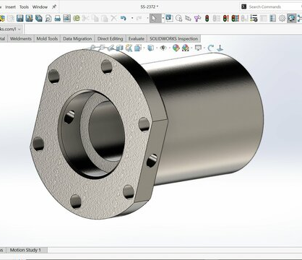
Section 03
03
Component Description
Stepped Mechanical Shaft
The primary component is a stepped mechanical shaft featuring strategic diameter variations along its length. These stepped sections serve distinct functional purposes:
Bearing mounting surfaces
Gear/pulley seats
Fillet radii for stress relief
Functional length sections
Supporting Bracket/Base
The supporting bracket or base component is engineered to securely hold the shaft while maintaining structural stability under operational loads:
Assembly Integration
Bearing housing integration
Mounting flange design
Both components work in harmony to create a complete mechanical system suitable for power transmission applications in industrial machinery.
Rib reinforcement structure
Alignment features

Slide 6
Section 04
Design Features
Five critical engineering elements incorporated into the design
01
Stepped Shaft Design
02
Fillets & Radii
03
Dimensional Control
Functional separation of sections through strategic diameter changes, enabling proper component seating and load distribution.
Minimize stress concentration at diameter transitions, preventing fatigue failure and extending component service life.
Accurate dimensional control based on provided engineering drawings, ensuring precision and interchangeability.
Multiple diameter transitions
Smooth corner transitions
Tight tolerance adherence
04
Smooth Transitions
05
Proper Alignment
Smooth transitions between different shaft diameters, reducing stress risers and improving fatigue resistance.
Proper alignment between shaft and support component, ensuring concentricity and minimizing vibration.
Continuous surface geometry
Concentric bore design
Design Excellence: Each feature contributes to overall system reliability, manufacturability, and performance optimization.

Slide 7
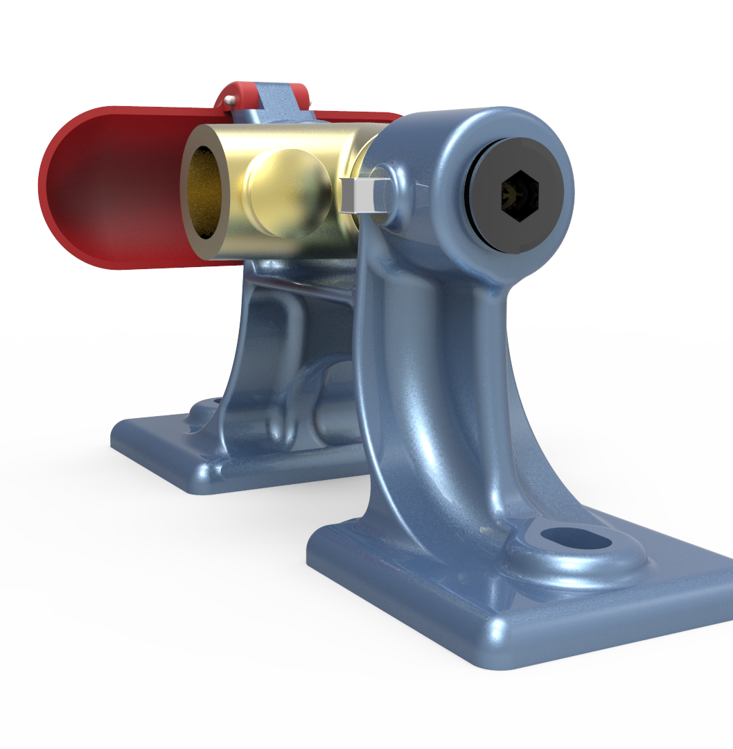
Section 05
05
Design Methodology
Five-step systematic approach to component design
01
Engineering Drawing Analysis
Careful analysis of the provided engineering drawing to understand overall geometry, critical dimensions, and functional requirements. This includes reviewing orthographic views, section details, and dimensional tolerances.
02
Critical Dimension Identification
Identification of critical dimensions and features that directly impact functionality, assembly, and manufacturing. Establishing dimensional chains and geometric relationships.
03
Basic Geometry Creation
Creation of basic geometry using sketches in CAD environment. Developing 2D profiles that define the shaft's cross-sectional shape and support structure outline.
04
Feature Addition
Addition of fillets and detailed features such as chamfers, keyways, and mounting holes. Applying surface finishes and refining geometric transitions.
Quality Assurance
05
Final Verification
Final verification of dimensions and geometry against original specifications. Conducting interference checks and ensuring design intent is maintained throughout.
Each step completed while maintaining accuracy and design intent, ensuring the final model meets all engineering requirements.

Slide 8
Section 06
Engineering Considerations
Four critical aspects evaluated during the design process
Manufacturability
Assembly Ease
Manufacturability of the shaft using standard machining processes such as turning, milling, and grinding. Design features accommodate conventional tooling and fixturing requirements.
Ease of assembly between shaft and support components through proper tolerancing, alignment features, and accessible fastening points. Minimizing assembly time and complexity.
Turning
Milling
Proper clearance fits
Alignment guides
Grinding
Drilling
Accessible fasteners
Structural Integrity
Design Principles
Structural integrity of the support component under anticipated operational loads. Rib reinforcements and optimized wall thickness ensure rigidity without excessive material usage.
Practical application of mechanical design principles including stress analysis, material selection, and functional requirement satisfaction. Applying theoretical knowledge to real-world constraints.
Load analysis
Stress concentration
Rib reinforcement
Material properties
Material optimization
Functional design
Holistic Approach: Each consideration ensures the design is not only functional but also practical for production and long-term operation.

Slide 9
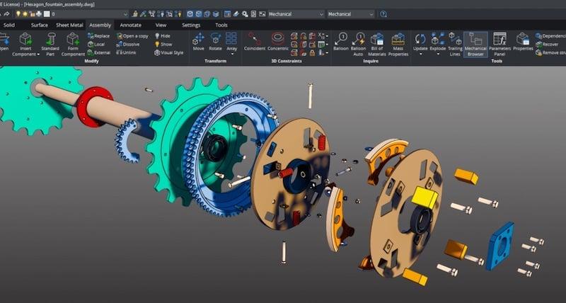
Section 07
07
Skills and Tools Used
Five core competencies developed and applied
CAD Modeling
Dimensioning & Tolerancing
CAD modeling proficiency using industry-standard software to create precise 3D geometries. Mastering sketch-based modeling, feature operations, and assembly constraints.
Dimensioning and tolerancing expertise applying GD&T standards. Specifying size, location, and geometric controls for manufacturing.
Problem Solving
Problem-solving and design thinking approach to overcome technical challenges. Iterative refinement and creative solution development.
Component Design
Mechanical component design skills for creating functional parts that meet performance requirements. Understanding fit, form, and function relationships.
Drawing Interpretation
Engineering drawing interpretation abilities to translate 2D technical documentation into 3D models. Reading orthographic projections, sections, and detail views.
Skill Development: This project provided hands-on experience with industry-relevant tools and methodologies essential for mechanical engineering practice.

Slide 10
Section 08
Learning Outcomes
Four key competencies gained through project completion
Shaft Design Understanding
2D-to-3D Conversion Skills
Better understanding of shaft design and support structures through practical application. Grasping the relationship between geometry, material selection, and functional performance in power transmission systems.
Improved ability to convert two-dimensional drawings into accurate three-dimensional models. Developing spatial reasoning and technical interpretation skills essential for design engineers.
Advanced competency achieved
Spatial visualization enhanced
Real-World Design Exposure
CAD Confidence
Practical exposure to real-world mechanical design practices including industry standards, manufacturing constraints, and quality requirements. Understanding the complete design-to-production workflow.
Increased confidence in CAD-based modeling through repeated application of modeling techniques. Building proficiency in feature creation, assembly management, and design validation.
Industry readiness improved
Technical proficiency gained
Comprehensive Growth: These outcomes represent significant advancement in mechanical design competency, preparing for more complex engineering challenges.

Slide 11
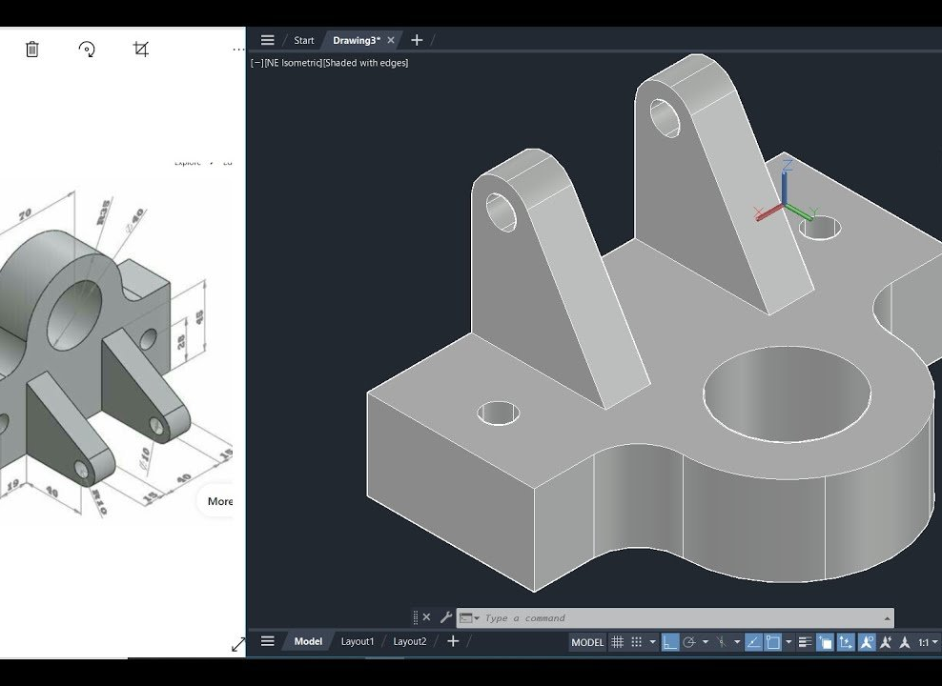
Section 09
09
Conclusion
Strong Learning Experience
This project served as a strong learning experience in mechanical design and CAD modeling. The hands-on approach provided invaluable insights into the practical challenges and solutions inherent in engineering design work.
Theory to Practice Bridge
It bridged the gap between theoretical knowledge and practical application, transforming classroom concepts into tangible design solutions. This integration is essential for developing professional engineering competence.
Project Success Metrics
Foundation for Growth
Design Accuracy
It represents an important step in developing core mechanical engineering skills, establishing a solid foundation for future projects and professional advancement in the field.
Technical Skills
Problem Solving
Knowledge Application
Looking Forward: This project marks the beginning of a journey toward advanced mechanical design expertise, with each experience building upon the last.

Slide 12
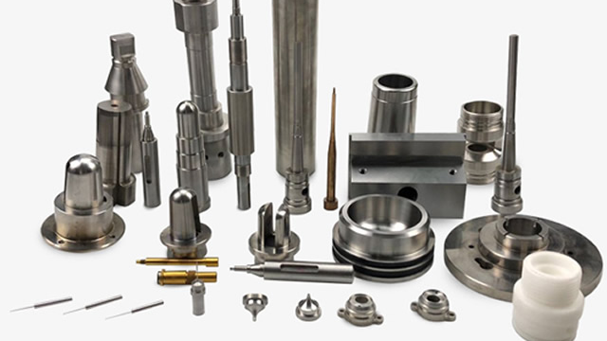
Thank You
Questions & Discussion
Contact
Feedback
Collaboration
Open for Discussion
Welcome & Appreciated
Future Opportunities
Mechanical Shaft and Support Component Design
12

